Slide 1
RECURRENT NEURAL NETWORK
PRESENTED BY
DHARANI THIRUMALAISAMY

Slide 2
OBJECTIVES
Introduction
CNN vs RNN
RNN working
Types of RNN
Vanishing Gradients
Types of Architectures in RNN
LSTM
GRU
Applications
References

Slide 3

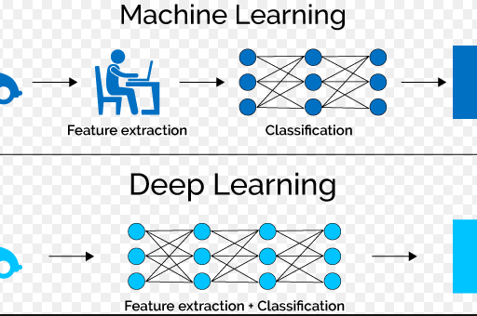
INTRODUCTION
Deep learning is a family member of machine learning.
Uses Neural Network to analyze data , predict and classify.
Deep learning – CNN , RNN.

Slide 4
CNN vs RNN
Extended architecture of ANN is CNN and RNN.
CNN is mainly used for classification problems and also computer vision applications.
RNN is used for Time-series problems and NLP applications.
The main difference between CNN and RNN is , RNN has memory cell which CNN doesn’t.

Slide 5
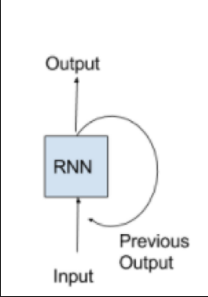
RNN [ Definition ]
RNN – Recurrent Neural Network
Going by the diagram on the side , the output from a RNN not only depends on the input that is given at that time but also depends on the previous states of the neuron which is stored in the network.

Slide 6
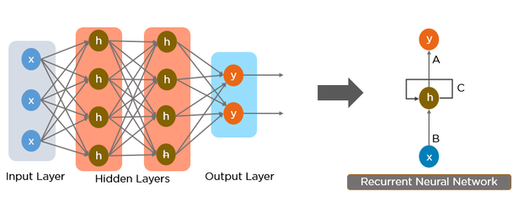
DIAGRAMATIC REPRESENTATION OF A SIMPLE RECURRENT NEURAL NETWORK

Slide 7
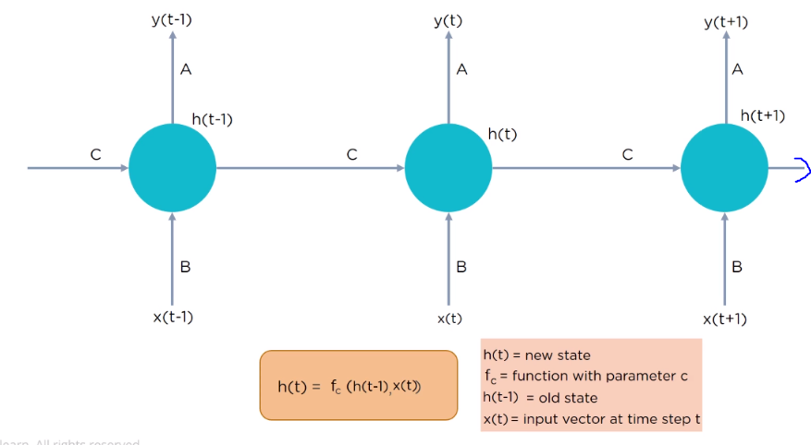
RNN [Working]

Slide 8
RNN [Working]
x – input
h – hidden layer
y – output
c – memory loop
These are the parameters in RNN.
t – time
The output at time t is predicted from the input that is given at time t and the memory state of the previous output ( IE., at time t-1) which is given as input to the hidden layer at time t

Slide 9
RNN [Working]
For a RNN there is a set of weights which is applied through time. So when a input is given at time t-1 , the input gets multiplied with these weights and gives an output and also the network stores a initial state . Now , when another input is given to the network at time t , this input gets multiplied with the weights and the initial state that was stored at time t-1 comes in and gets multiplied by different weights.
These 2 combined produces the output at time t for the input given at time t.
After this process, the state gets updated and the steps repeat till the final neuron.

Slide 10
TYPES OF RNN
One – to – one RNN : Vanilla Neural network which is used for simple machine learning problems.
One – to – many : Single input but multiple outputs. Used in image captioning applications.
Many – to – one : Sentimental analysis application. Takes in a sequence of words( sentences) and classifies if it a positive , negative or neutral sentiments.
Many – to – many : Machine translation . Sequence of English words(say a sentence in English) is translated to a sentence in another language.

Slide 11
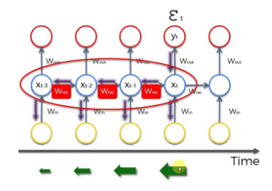
VANISHING GRADIENT PROBLEM
When talking about RNN , the topic is never complete without talking about VANISHING GRADIENT and EXPLOADING GRADIENT problem.

Slide 12
VANISHING GRADIENT
Say , we want to predict the output of x at time t . For that , the weights before this layer should be updated.
Here , is the cost function to be minimized. For that we have to pass throught x(t) , x(t-1) , x(t-2) and x(t-3) to upgrade the weights.
Say the weight of NN (w(rec)) is 1000 at x(t) and as it moves backwards it keeps decreasing which is shown by the green arrow.
As the gradient decreases as time goes , the weight will stop getting updated at one point as the gradient will hold very small value.

Slide 13
Larger the gradient , the faster the weights get updated.
Say , at x(t-4) the gradient becomes small and weights stop getting updated.
Since in RNN , the input at x(t) is affected by the weights at x(t-1) , if weights at x(t-4) doesn’t get updated then x(t-3) which takes input from x(t-4) will also be affected and so is the case for x(t-2) , x(t-1) and x(t).
This simply means the model won’t be trained properly.
This is the vanishing gradient problem.
In order to avoid this , weights are initialized before hand.
Second solution to this is ECHO STATE NETWORK . This is a network that Is designed to overcome this problem.
Third solution is to use LSTM (Long Short-Term Memory)

Slide 14
EXPLOADING GRADIENT PROBLEM
This is similar to vanishing gradient , but in this case the gradients value increases as time goes by and will reach a point where it will become difficult for the weights to get updated.
In order to avoid this gradient clipping is implemented. Which means , a limit is initially set for the gradient value and if it crosses the value , it is replaced with the gradient limit.
For example , say the maximum gradient value is 1000 but the value goes to 2000 , then this 2000 will be considered as 1000 by the network.

Slide 15
ARCHITECTURES OF RNN
Fully Recurrent
Recursive
Echo State
LSTM
Gated Recurrent Unit
Bi-directional
Neural Turing machines

Slide 16
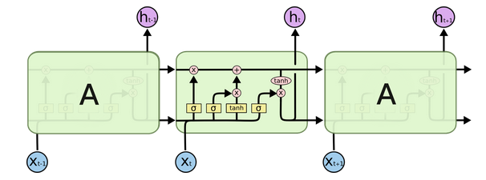
Long Short-Term Memory [LSTM]
This is a repeating module in LSTM that contains interacting layers.

Slide 17
LSTM
They are special kind of RNN which can retain information about the past for a very long period of time.
Instead of a single layer , they have four recurrent layers that are interacting in a special way.
They work freely over time , so when we backpropagate there won’t be any problem with the vanishing gradients.
c - memory cell ;
h – output ;
x- input ;
Sigmoid and tanh – layer operation

Slide 18


LSTM [Working]
Step 1 : It decides how much of the past memory to retain.
It is done by the sigmoid function.
In this case , we have a output from the previous layer and a new input which is x(t) . Together , the sigmoid function decides whether to open the valve.
It is a valve that operates on the command of sigmoid function letting new memory flow into the system.

Slide 19
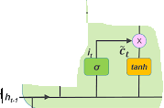
LSTM [Working]
Step 2 : This module decides how much of the memory added In the past step should be added to the input.
It is based on the significance of the memory retained in the current time step.

Slide 20
LSTM [Working]
Step 3: Consider the before (+)
Valve as valve 1 and the one below (+) as valve 2. S o , if we keep the valve 2 closed and valve 1 open , there won’t be any change in the memory whereas , if valve 1 is closed and valve 2 is open , there will be an update in the memory.
Step 4 : This part of the architecture decides what goes as output from the updated memory.

Slide 21
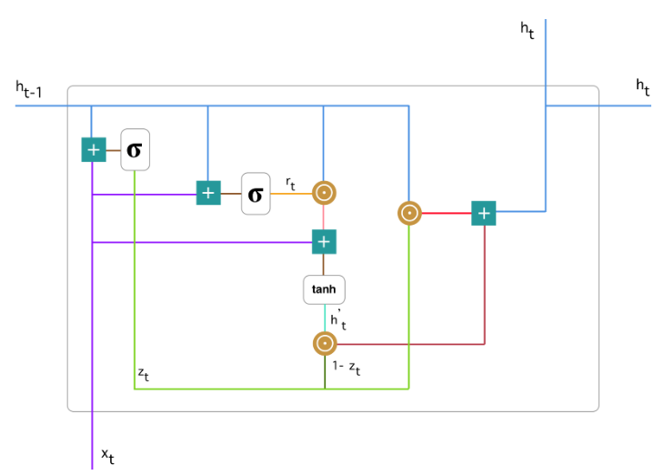
GATED RECURRENT UNIT(GRU)
This is another architecture of RNN that is commonly used apart from LSTM.

Slide 22
GRU
It is a architecture that was built to avoid Vanishing Gradient Problem.
It has a update gate and a reset gate which together decides what should be given as the output of the model.
The green flow , is the update gate and the purple is the reset gate.
The update gate decides how much of the past information should be passed on to the future.
Reset gate decides how much of the past information to forget.

Slide 23
GRU
To calculate the current memory content , multiply h(t-1) with weight w and x(t) with weight u.
Later element wise operation is done on h(t-1).u and r(t)
The answer from above two steps is summed and nonlinear function tanh is applied to calculate the current memory content.
To calculate the final memory state , element wise operation is carried out between z(t) and h(t-1) and between z(1-t) and h(t)
The answers are summed up to get the final memory at current time step.

Slide 24
APPLICATIONS
Machine Translation
Image Captioning
Hand writing generation
Video to text
Chatbot (question - answer)

Slide 25
REFERENCES
https://en.wikipedia.org/wiki/Recurrent_neural_network
https://towardsdatascience.com/an-introduction-to-recurrent-neural-networks-72c97bf0912
https://medium.com/@datamonsters/artificial-neural-networks-for-natural-language-processing-part-1-64ca9ebfa3b2
https://www.quora.com/What-is-the-difference-between-CNN-and-RNN
https://towardsdatascience.com/understanding-gru-networks-2ef37df6c9be

